Slide 1
PRAIS

Slide 2
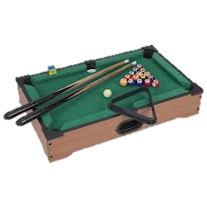
PRAIS
Table top pool table

Slide 3
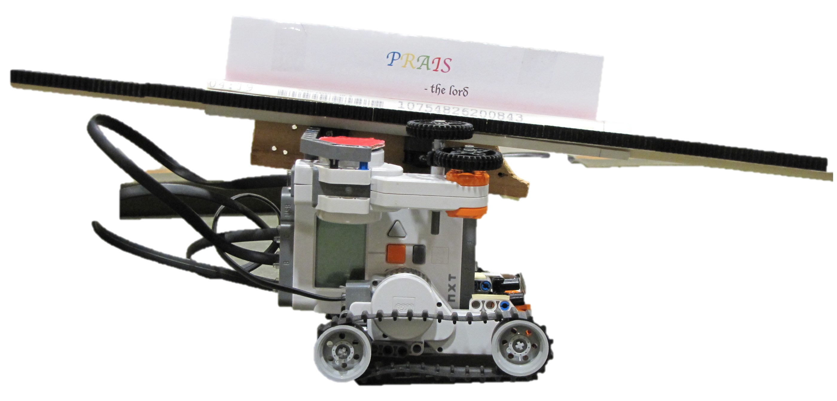
PRAIS
Robot built with LEGO
Mindstorms
Table top pool table

Slide 4
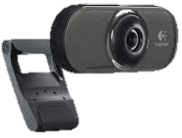
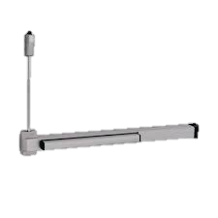
PRAIS
Camera mount
Robot built with LEGO
Mindstorms
Table top pool table

Slide 5
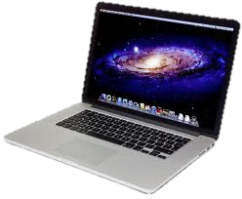
PRAIS
PRAIS Software
Camera mount
Robot built with LEGO
Mindstorms
Table top pool table

Slide 6
PRAIS
PRAIS Software
Camera mount
Image capture
Robot built with LEGO
Mindstorms
Table top pool table

Slide 7
PRAIS
PRAIS Software
Camera mount
Identify & locate balls
Robot built with LEGO
Mindstorms
Table top pool table

Slide 8
PRAIS
PRAIS Software
Camera mount
Identify & locate balls
Identify & locate bot
Robot built with LEGO
Mindstorms
Table top pool table

Slide 9
PRAIS
PRAIS Software
Camera mount
Identify & locate balls
Identify & locate bot
Find best shot
Robot built with LEGO
Mindstorms
Table top pool table

Slide 10
PRAIS
PRAIS Software
Camera mount
Identify & locate balls
Identify & locate bot
Find best shot
Instruct bot to play shot
Robot built with LEGO
Mindstorms
Table top pool table

Slide 11

PRAIS
PRAIS Software
Camera mount
Robot built with LEGO
Mindstorms
Table top pool table

